Slide 1

Consumer Behavior: Buying, Having, and Being
Twelfth Edition
Chapter 9
Decision Making
Copyright © 2017, 2015, 2013 Pearson Education, Inc. All Rights Reserved.
Notes:
If this PowerPoint presentation contains mathematical equations, you may need to check that your computer has the following installed:
1) MathType Plugin
2) Math Player (free versions available)
3) NVDA Reader (free versions available)
This chapter defines the scope of international business and introduces us to some of its most important topics.

Slide 2
Learning Objectives (1 of 3)
9.1 The three categories of consumer decision-making are cognitive, habitual, and affective.
9.2 A cognitive purchase decision is the outcome of a series of stages that results in the selection of one product over competing options.
9.3 The way information about a product choice is framed can prime a decision even when the consumer is unaware of this influence.
9.4 We often fall back on well-learned “rules-of-thumb” to make decisions.

Slide 3
Learning Objectives (2 of 3)
9.5 Marketers often need to understand consumers’ behavior rather than a consumer’s behavior.
9.6 The decision-making process differs when people choose what to buy on behalf of an organization rather than for personal use.
9.7 Members of a family unit play different roles and have different amounts of influence when the family makes purchase decisions.

Slide 4
Learning Objective 9.1
The three categories of consumer decision-making are cognitive, habitual, and affective.
Notes:
The first learning objective in this chapter points out that consumers make decisions in different ways. Some of our decisions are highly rational. Others are made by habit. Still others are made on the basis of emotion.

Slide 5
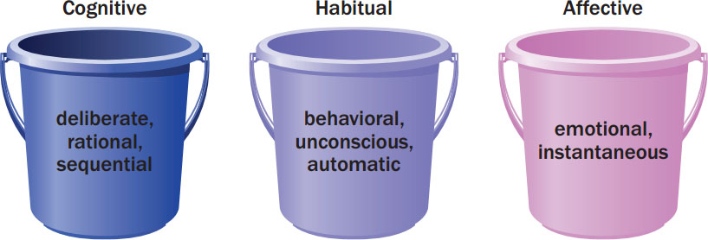
Figure 9.1 Three Types of Decision-Making
Figure 9.2 Stages in Consumer Decision Making
Notes:
This image illustrates the three types of decision-making: cognitive, habitual, and affective.

Slide 6
Problem?
Consumer hyperchoice
Constructive processing
Mental budget
Notes:
Consumer hyperchoice forces us to make repeated decisions that may drain psychological energy while decreasing our abilities to make smart choices.
Constructive processing argues that we evaluate the effort we’ll need to make a particular choice and then tailor the amount of cognitive “effort” we expend to get the job done.
Mental budget that helps us to estimate what we will consume over time so that we can regulate what we do in the present.

Slide 7
Self-Regulation
Implementation intentions
Counteractive construal
Feedback loop
Morning Morality Effect
Executive control center
Notes:
A person’s efforts to change or maintain his or her actions over time, whether these involve dieting, living on a budget, or training to run a marathon, involve careful planning that is a form of self-regulation.
These “if-then” plans or implementation intentions may dictate how much weight we give to different kinds of information (emotional or cognitive), a timetable to carry out a decision, or even how we
will deal with disruptive influences that might interfere with our plans (like a bossy salesperson who tries to steer us to a different choice).
Counteractive construal when they exaggerate the negative aspects of behaviors that will interfere with the ultimate goal.
A feedback loop is when we provide people with information about their actions in real time, and then give them a chance to change those actions so that you push them to improve.
“Morning Morality Effect shows that people are more likely to cheat, lie, or even commit fraud in the afternoon than in the morning.
Executive control center that we use for important decision making, including moral judgments, can be worn down or distracted even by simple tasks like memorizing numbers.

Slide 8
For Reflection (1 of 6)
Provide an example when the feedback loop was used on you.
Notes:
Consider purchases you’ve made that reflect the five kinds of risk.

Slide 9
Learning Objective 9.2
A cognitive purchase decision is the outcome of a series of stages that results in the selection of one product over competing options.
Notes:
Traditionally, consumer researchers have approached decision-making from an information-processing perspective. According to this view, people calmly and carefully integrate as much information as possible with what they already know about a product, weigh the pluses and minuses of each alternative, and arrive at a satisfactory decision. The economics of information perspective assumes that we collect just as much data as we need to make an informed decision.

Slide 10
Steps in the Decision-Making Process
Problem recognition
Information search
Evaluation of alternatives
Product choice
Notes:
These are the basic four steps in the decision making process. The next several slides provide more details on these steps.
Problem recognition occurs when we experience a significant difference between the current state of affairs and some state we desire. Information search is the process by which we survey the environment for data to make a reasonable decision. In the third stage, the consumer evaluates the alternatives. Then a choice is made. The choice may be from among product choices as well as to buy or not.

Slide 11
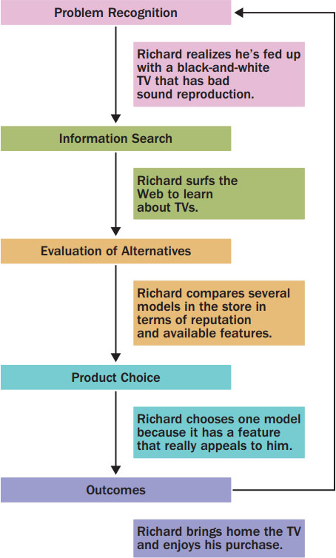
Consumer Decision Making
Figure 9.2 Stages in Consumer Decision Making
Notes:
This figure illustrates the stages we discussed in our last slide with an example about Richard.

Slide 12
Stage 1: Problem Recognition
Occurs when consumer sees difference between current state and ideal state
Need recognition: Actual state declines
Opportunity recognition: Ideal state moves upward
Notes:
Problem recognition is the first stage. It can occur when a consumer’s state of being declines (which then triggers a desire to return to normalcy) or when a consumer recognizes an ideal state he or she wishes to achieve.

Slide 13
Stage 2: Information Search
The process by which we survey the environment for appropriate data to make a reasonable decision.
Prepurchase or ongoing search
Internal or external search
Online search and cybermediaries
Notes:
Once we know we have a problem, we search out how we can solve the problem. These searches will typically take place before purchase (prepurchase). However, many people just enjoy searching information and they conduct ongoing searches even if a purchase is not immediately forthcoming. Internal searches are based on our own memory banks while external sources come from other sources. Search engines have made vast amounts of information available to us as we search out product information. We may rely on cybermediaries to help narrow and filter the options that are available. Intelligent agents are sophisticated software programs that use collaborative filtering technologies to learn from past user behavior in order to recommend new purchases.

Slide 14
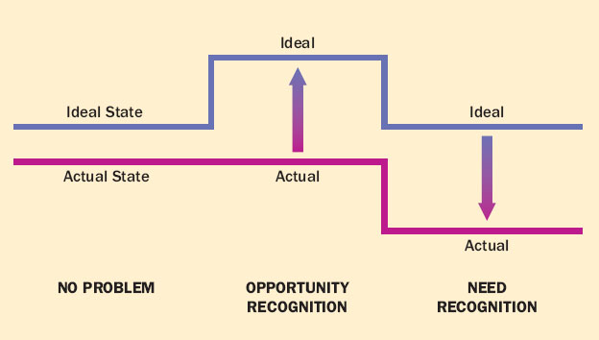
Figure 9.3 Problem Recognition
Figure 9.3 Problem Recognition: Shifts in Actual or Ideal States Does
Notes:
This figure illustrates the two causes of problem recognition. The person experiences a decline in the quality of his actual state or an increase in the desire for his ideal state.

Slide 15
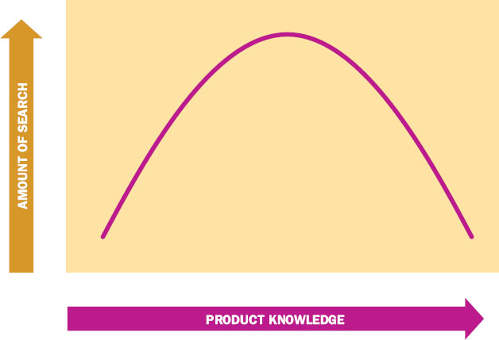
Figure 9.4 Amount of Information Search and Product Knowledge
Figure 9.4 The Relationship Between Amount of Information Search and Product Knowledge
Notes:
This figure shows us that there is an inverted-U relationship between knowledge and external search effort. People with very limited expertise may not feel they are competent to search extensively. Experts have a better sense of what information is relevant so they engage in selective search. Novice consumers tend to process information in terms of the big picture instead of detailed information. Who searches the most? Moderately knowledgeable consumers.

Slide 16
Step 3: Alternatives
Evoked Set
Consideration Set
Notes:
The alternatives a consumer knows about is the evoked set. The ones actually considered make up the consideration set. In this ad for Sunkist lemons, the goal is to illustrate lemons as a possible alternative to salt.

Slide 17
For Reflection (2 of 6)
Is it a problem that consumers have too many choices? Would it be better to have less choices? How does it affect consumer decision-making?

Slide 18
Learning Objective 9.3
The way information about a product choice is framed can prime a decision even when the consumer is unaware of this influence.

Slide 19
Product Choice
Step 4: Product choice
Feature creep
Step 5: Postpurchase evaluation
Neuromarketing
Notes:
Feature creep is the complexity of features that products provide.
Neuromarketing uses functional magnetic resonance imaging (or fMRI), a brain-scanning device that tracks blood flow as we perform mental tasks to take an up-close look at how our brains respond to marketing messages and product design features.

Slide 20

Online Decision Making
Cybermediary
Intelligent agents
Search engines
Search engine optimization
Long tail
Notes:
A cybermediary often is the answer. This term describes a Web site or app that helps to filter and organize online market information so that customers can identify and evaluate alternatives more efficiently.
Intelligent agents are sophisticated software programs that use collaborative filtering technologies to learn from past user behavior to recommend new purchases.
Search engine optimization (SEO) refers to the procedures companies use to design the content of Web sites and posts to maximize the likelihood that their content will show up when someone
searches for a relevant term.
Long tail is that we no longer need to rely solely on big hits (such as blockbuster movies or best-selling books) to find profits.

Slide 21
Strategic Implementation of Product Categories
Position a product
Identify competitors
Create an exemplar product
Locate products in a store

Slide 22
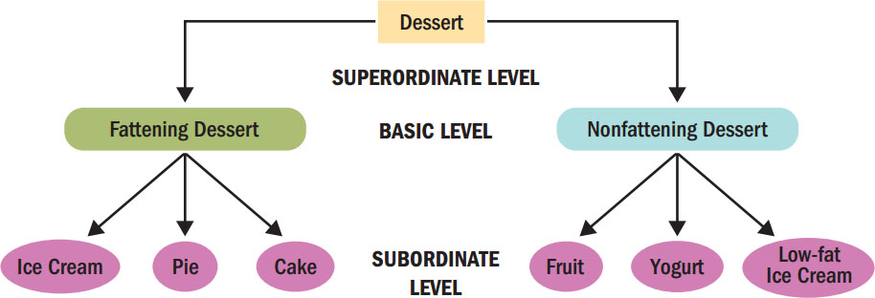
Figure 9.5 Levels of Categorization

Slide 23
Evaluative Criteria
Table 9.1 Hypothetical Alternatives for a TV Set
Brand Ratings | Blank | Blank | Blank | Blank
Attribute | Importance Ranking | Prime Wave | Precision | Kamashita
Size of screen | 1 | Excellent | Excellent | Excellent
Stereo broadcast capability | 2 | Poor | Excellent | Good
Brand reputation | 3 | Excellent | Excellent | Poor
Onscreen programming | 4 | Excellent | Poor | Poor
Cable-ready capability | 5 | Good | Good | Good
Sleep timer | 6 | Excellent | Poor | Good
Notes:
When evaluating alternatives, consumers may focus on one or two product features while ignoring others. This helps us narrow down our options. Evaluative criteria are the dimensions we use to judge the merits of competing options. Determinant attributes are the features that we actually use to differentiate among our choices. Marketers often educate consumers about which criteria they should use as determinant attributes.

Slide 24
Compensatory Rule
Simple additive rule leads to the option with the largest number of positive attributes
Weighted additive rule allows consumer to take in to account the relative importance by weighting.

Slide 25
Noncompensatory Decision Rules
Lexicographic rule: consumers select the brand that is the best on the most important attribute
Elimination-by-aspects rule: must have a specific feature to be chosen
Conjunctive rule: entails processing by brand
Notes:
When we need to use more consideration before making a decision (an extensive problem), we can categorize our decision rules into compensatory and noncompensatory. Noncompensatory decision rules suggest that a product that is low on one attribute cannot compensate for that weakness with a strength on another attribute.

Slide 26
For Reflection (3 of 6)
Think of some of the common country of origin effects (e.g., watches, wine). Which ones affect your consumer choices? What could brands from other countries do to compete such effects?

Slide 27
Learning Objective 9.4
We often rely on rules-of-thumb to make routine decisions.

Slide 28
Biases in Decision-Making Process
Mental accounting: framing a problem in terms of gains/losses influences our decisions
Sunk-cost fallacy: We are reluctant to waste something we have paid for
Loss aversion: We emphasize losses more than gains
Prospect theory: risk differs when we face gains versus losses
Notes:
Cognitive decision making seeks a maximizing solution but often times consumers are happy to exert less energy for decisions in exchange for a satisficing solution. This “good enough” perspective on decision making is called bounded rationality. The study of decisions is called behavioral economics.
Many of these decisions illustrate the principles of mental accounting.

Slide 29
Heuristics
Covariation
Country of Origin
Familiar Brand Names
Higher Prices
Notes:
Covariation infers hidden dimensions of products from attributes we observe. The signal communicates an underlying quality. For instance, someone selling a used car will try to make the car look clean because cleanliness may be associated with reliability. Country of origin is often a determinant attribute in the decision-making process. Consumers think of Switzerland for precision in watches, Italy for leather goods, and France for wine. Familiar brand names can serve as a shortcut as can higher prices, which consumers may assume suggest higher quality.

Slide 30
For Reflection (4 of 6)
When have you made a high involvement decision on the basis of affect?
Were you in a maximizing mode or satisficing mode?

Slide 31
Learning Objective 9.5
Marketers often need to understand consumers’ behavior rather than a consumer’s behavior.

Slide 32
Roles In Collective Decision Making
Initiator
Gatekeeper
Influencer
Buyer
User
Notes:
Depending on the decision in question, the choice may include some or all group members and different group members may play different roles. The initiator role is played by the person who brings up the idea or identifies the need. The person who conducts the information search and controls the flow of information available to the group is the gatekeeper. The person who tries to sway the outcome of the decision is the influencer. The person who actually makes the purchase is the buyer. Those who will actually use the product are the users.

Slide 33
Learning Objective 9.6
The decision-making process differs when people choose what to buy on behalf of an organization rather than for personal use.

Slide 34
Organizational Decision Making
Organizational buyers: purchase goods and services on behalf of companies for use in the process of manufacturing, distribution, or resale.
Business-to-business (B2B) marketers: specialize in meeting needs of organizations such as corporations, government agencies, hospitals, and retailers.
Notes:
Organizational buyers have a lot of responsibility. These individuals buy from B2B marketers.

Slide 35
Compared to Consumer Decision Making, Organizational Decision Making…
Involves many people
Requires precise, technical specifications
Is based on past experience and careful weighing of alternatives
May require risky decisions
Involves substantial dollar volume
Places more emphasis on personal selling
Notes:
Although there are similarities between consumer and organizational buying, there are some key differences. These are listed on the slide.

Slide 36
What Influences Organizational Buyers?
The buyclass theory of purchasing divides organizational buying decisions into 3 types:
Level of information required
Seriousness of decision
Familiarity with purchase
Notes:
Organizational buyers are influenced by several factors including the psychological characteristics of those involved in the buying decision, external stimuli such as the nature of the industry and the organization, cultural factors, and the level of risk and complexity involved in the decision. The level of complexity depends upon the level of information the buyer must gather prior to the decision, the seriousness of the decision and the evaluation of alternatives, and how familiar the buyer is with the type of purchase.

Slide 37
Buying Decisions
Buyclass theory: organizational buying decisions divided into three types, ranging from most to least complex.
Table 9.3 Types of Organizational Buying Decisions
Buying Situation | Extent of Effort | Risk | Buyer’s Involvement
Straight rebuy | Habitual decision-making | Low | Automatic reorder
Modified rebuy | Limited problem solving | Low to moderate | One or a few
New task | Extensive problem solving | High | Many
Source: Adapted from Patrick J. Robinson, Charles W. Faris, and Yoram Wind, Industrial Buying and Creative Marketing (Boston: Allyn & Bacon, 1967).
Notes:
When we apply the buyclass theory of purchasing, we divide organizational buying decisions into three types ranging from least to most complex. How much cognitive effort goes into making a decision affects what type of decision the buyer is making. The three basic types of decisions are straight rebuy, modified rebuy, and new task. The straight rebuy is a habitual decision. A modified rebuy involves limited decision making. A new task involves extensive problem solving because the company has not made a similar decision already.

Slide 38
B2B e-commerce
Prediction market
Crowdsourcing
Wisdom of crowds
Notes:
Business-to-business (B2B) e-commerce refers to Internet interactions between two or more businesses or organizations.
A prediction market is one of the hottest trends in organizational decision-making techniques.
The wisdom of crowds perspective (from a book by that name) argues that, under the right circumstances, groups are smarter than the smartest people in them.

Slide 39
For Reflection (5 of 6)
Assume that you are a sales representative for a large company that markets laptop computers.
List all the people that may be involved in making the decision to purchase from you.
Try to match all the people to their possible decision roles as outlined on the previous slide.

Slide 40
Learning Objective 9.7
Members of a family unit play different roles and have different amounts of influence when the family makes purchase decisions.

Slide 41
Household Decisions
Consensual Purchase Decisions
Accommodative Purchase Decisions
Notes:
Families make two types of decisions: 1) consensual and 2) accommodative.
Consensual purchase decisions are those for which members agree on the desired purchase, differing only in terms of how it will be achieved. Accommodative purchase decisions are those for which members have different preferences or priorities and they cannot agree on a purchase to satisfy the minimum expectations of all involved .

Slide 42

Resolving Decision Conflicts in Families
Interpersonal need
Product involvement and utility
Responsibility
Power
Notes:
Decisions involve conflict among family members to the extent that the issue is important or unusual or if individuals have strong opinions about alternatives. The degree to which these factors generate conflict determines the type of decision the family will make, whether that be a consensual agreement or an accommodative agreement. The factors that determine how much conflict there will be include interpersonal need, product involvement and utility, responsibility, and power.
Interpersonal need refers to the level of involvement of a person in the group. Product involvement and utility refers to the degree to which a person will use the product to satisfy a need. Responsibility refers to the person who has responsibility for procurement, maintenance, payment, and so on. Power refers to the degree to which one family member exerts influence over the others.

Slide 43
Who Makes Key Decisions in the Family?
Autonomic decision: one family member chooses a product
Syncretic decision: involve both partners
Used for cars, vacations, homes, appliances, furniture, home electronics, interior design, phone service
As education increases, so does syncretic decision making
Notes:
When couples first marry, they tend to make more joint decisions but over time, they begin to specialize in decisions. Wives still have the most say on grocery purchases, clothes, furniture, home electronics, and things for children. In traditional views of family, men made the money and women spent it. Today, it is primarily the woman who manages the role of family financial officer, whether or not she is a primary breadwinner. Marketers are also aware of the tendency for working mothers to struggle with a “juggling lifestyle.”

Slide 44
Social Shopping
Table 9.3 Types of Organizational Buying Decisions
Social Shopping Web Site Categories | Blank | Blank | Blank | Blank | Blank | Blank
Virtual Wish Lists/ Scrapbooking | Try it On Sites and apps | Pre-purchase Feedback | Competitions | Social Shopping advocacy | Group purchasing Sites | Linking and networking ‘Sign On’
Supply | Gotryiton | ASOS | ASOS | Klout | Living Social | Facebook Connect
Polyvore | Fashionism | Facebook | Blank | The Fancy | Groupon | Modcloth
Pinterest | Justboughtit | Twitter | Blank | Sneakpeeq | BuyWithMe | Wanelo
vi.sualize.us | Blank | Motilo | Blank | Fab | Blank | Blank
Mydeco | Blank | Daily grommet | Blank | Blank | Blank | Blank
Source: Adapted from Rachel Ashman, Michael R. Solomon and Julia Wolny, “An Old Model for a New Age: Applying the EKB in Today’s Participatory Culture,” Journal of Customer Behaviour, 2015, 14(2): 127–146.

Slide 45
For Reflection (6 of 6)
What exposure have you had to family decisions made in your own family? Can you see the patterns discussed in the chapter in those decisions? Give an example.

Slide 46
For Review (1 of 3)
The three categories of consumer decision-making are cognitive, habitual, and affective.
A cognitive purchase decision is the outcome of a series of stages that results in the selection of one product over competing options.
Notes:
In this chapter, we focused on four learning objectives. We learned the three categories of consumer decisions. We learned the stages in the cognitive decision-making process.

Slide 47
For Review (2 of 3)
The way information about a product choice is framed can prime a decision even when the consumer is unaware of this influence.
We often fall back on well-learned “rules-of-thumb” to make decisions.
Marketers often need to understand consumers’ behavior rather than a consumer’s behavior.

Slide 48
For Review (3 of 3)
The decision-making process differs when people choose what to but on behalf of an organization rather than for personal use.
Members of a family unit play different roles and have different amounts of influence when the family makes purchase decisions.

Slide 49

Copyright

